Slide 1
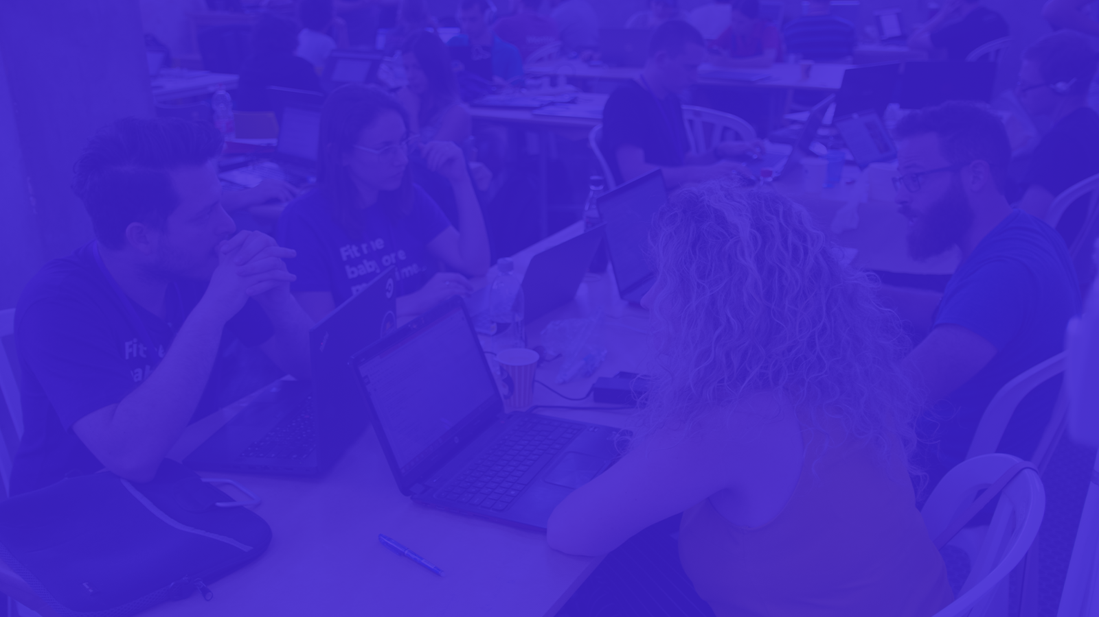
AlgoTrading
Reinforcement Learning for Trading

Slide 2
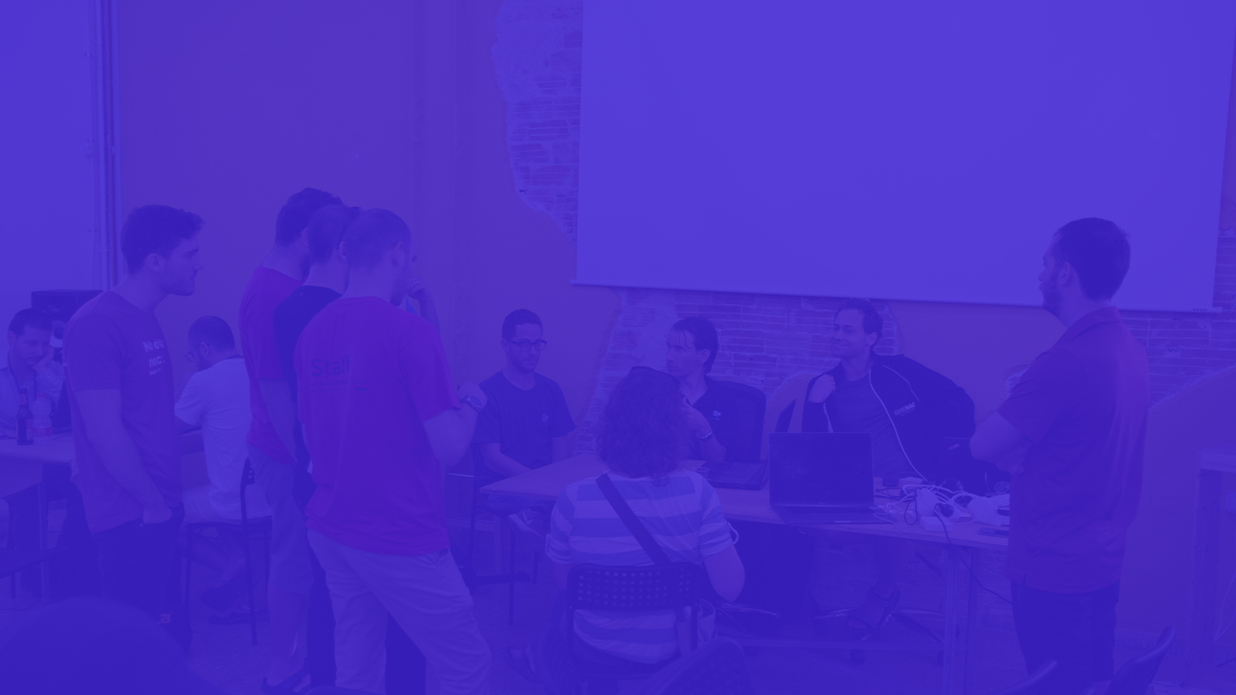
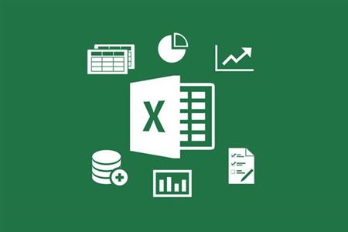

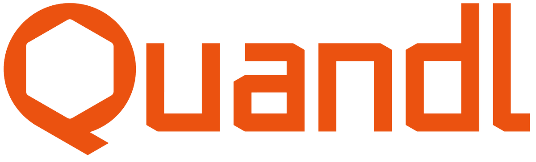
Dataset
Data
Open, High, Low, Adj Close,
Volume, Open Vix, Close Vix,
Skew…..
Source
Notes:
What is the data?
Where did we get it from?

Slide 3
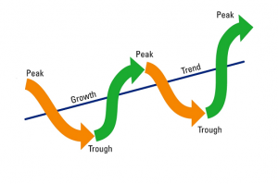
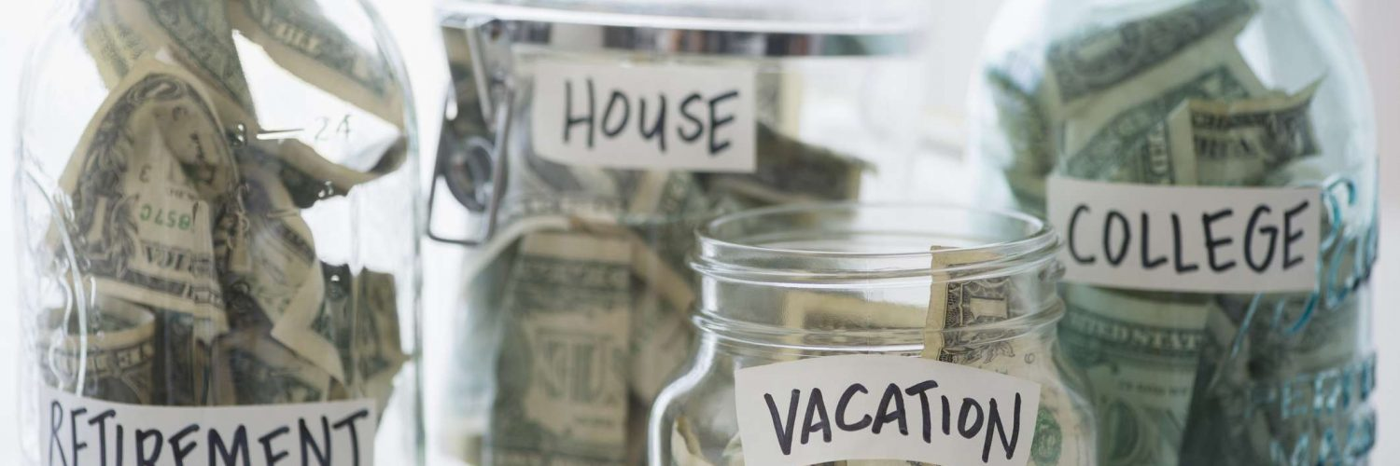
Problem
Protfolio Optimization

Slide 4
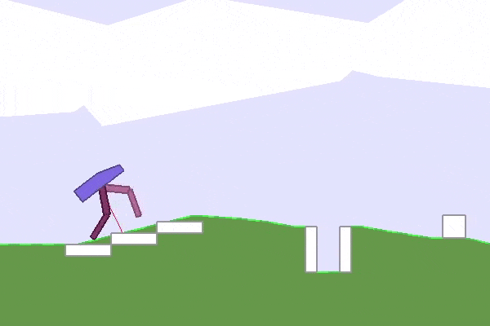
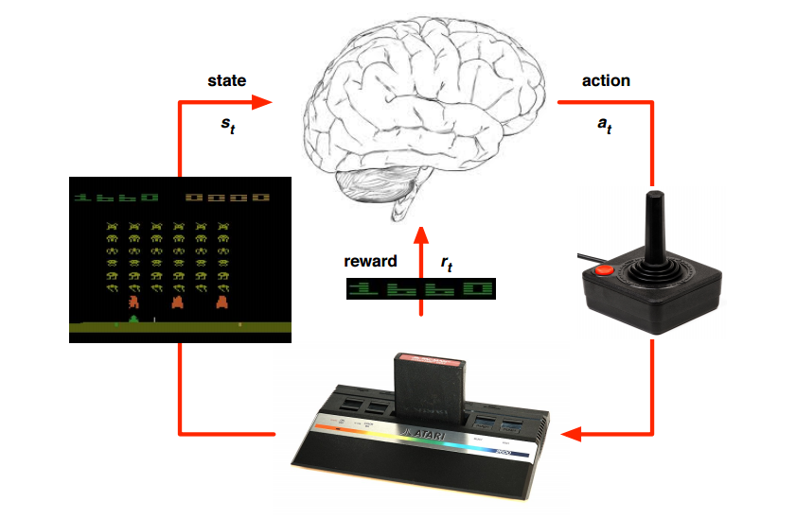
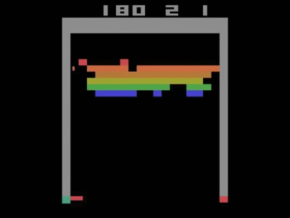
Solution
Reinforcement Learning
Notes:
How did we solve it?
Which algorithms did we use?
How well did we solve it?

Slide 5
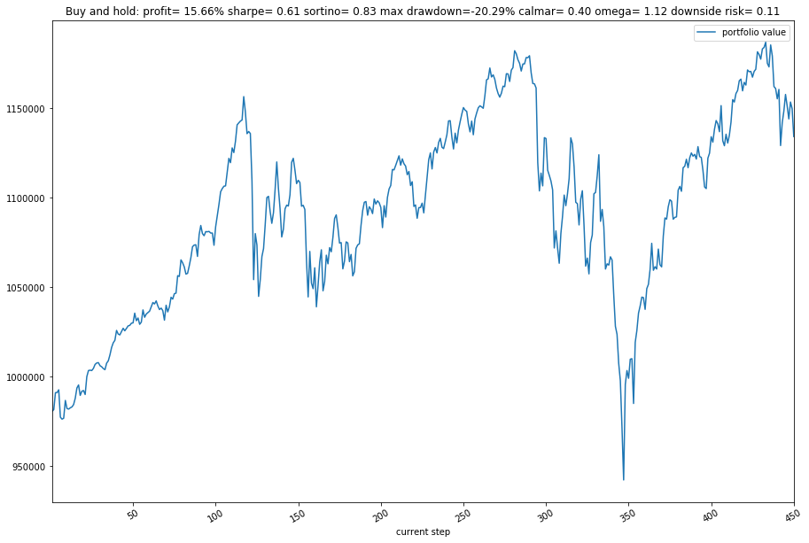
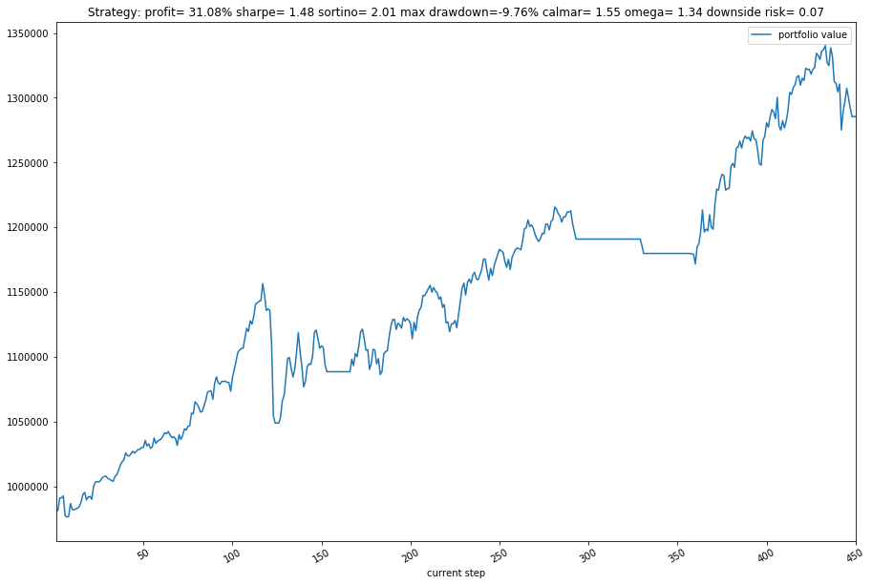
Solution
Test Performance:
Real VS PPO
Notes:
How did we solve it?
Which algorithms did we use?
How well did we solve it?

Slide 6
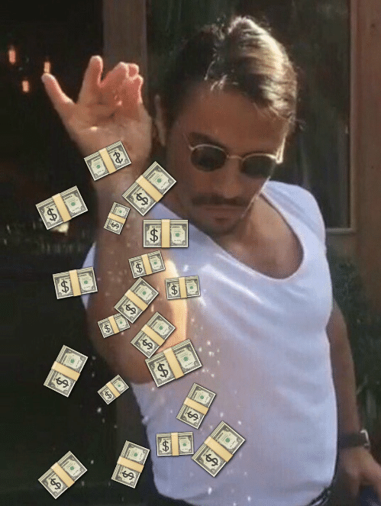
DataHack
The End
Notes:
How did we solve it?
Which algorithms did we use?
How well did we solve it?

